Slide 1
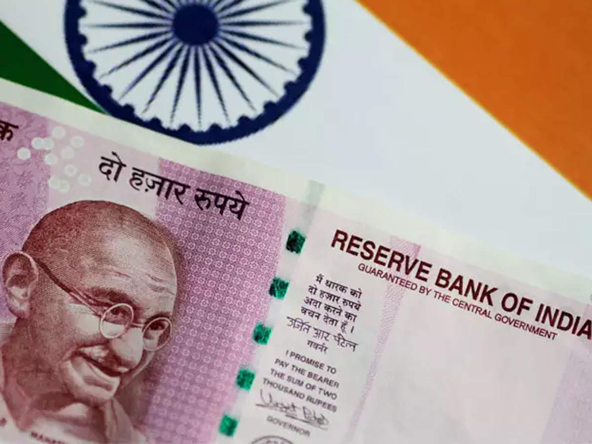
Fiscal Policy
Meaning of FP
The purpose of Fiscal Policy
Expansionary (or loose) Fiscal Policy
Deflationary (or tight) Fiscal Policy

Slide 2
Meaning of FP
Fiscal policy is carried out by the executive and legislative branches of government that make policy regarding government spending programs and taxation.
Unlike monetary policy that can be changed by the Central Bank, fiscal policy is part of the process of making laws and government budgeting.
Fiscal policy involves the Government changing the levels of Taxation and Govt Spending in order to influence Aggregate Demand (AD) and therefore the level of economic activity.
AD is the total level of planned expenditure in an economy .
AD = C+ I + G + X – M

Slide 3
Purpose of Fiscal Policy
Reduce the rate of inflation
Stimulate economic growth in a period of a recession.
aims to stabilise economic growth, avoiding the boom and bust of economic cycle.

Slide 4
Expansionary (or loose) Fiscal Policy
This involves increasing AD,
Therefore the govt will increase spending (G)
and cut taxes.
Lower taxes will increase consumers spending because they have more disposable income (C)
This will worsen the govt budget deficit
(See Samuelson, Chapter 24 - Fiscal Multiplier if you will come back after lockdown ) The graph for such fiscal expansion and its impact is being discussed in the next slide .

Slide 5
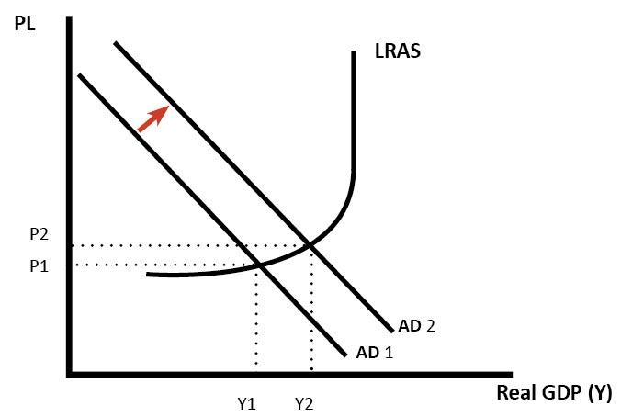
Graph for Expansionary FP

Slide 6
The Effects of Ex FP
When government cut income tax, it increases the disposable income of consumers and allow them to increase spending.
+ consumption will increase AD and this will lead to higher economic growth.
Gov. expenditure for public work schemes such as MANREGA would create jobs (even in the Corona crisis), it will increase incomes and lead to greater AD.

Slide 7
This injection of money into the economy due to FP may have positive Multiplier Effects .
The crux of multiplier is that total increase in income, output or employment is manifold the original surge in investment.
I am discussing to calculate Multiplier in the next slide.
This was a contribution by a great Economist called J M Keynes in 1930s.

Slide 8
Deflationary (or tight) Fiscal Policy
This involves decreasing AD
Therefore the govt will cut govt spending (G) and or increase taxes. Higher taxes will reduce consumer spending (C) .
Considering the formula of Multiplier
1/1-MPC x change in investment
or
1/MPS x change in investment
This will lead to an improvement in the government budget deficit
Fine Tuning : This involves maintaining a steady rate of economic growth through using fiscal policy.
The graph for such tight fiscal policy and its impact is being discussed on the board.

Slide 9
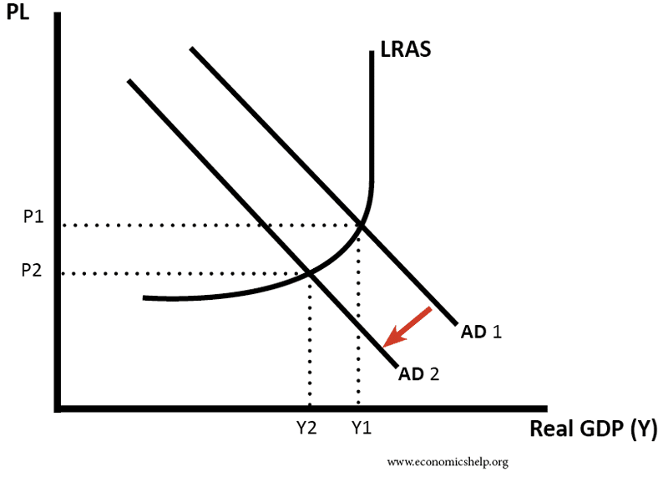
Graph for Deflationary FP

Slide 10
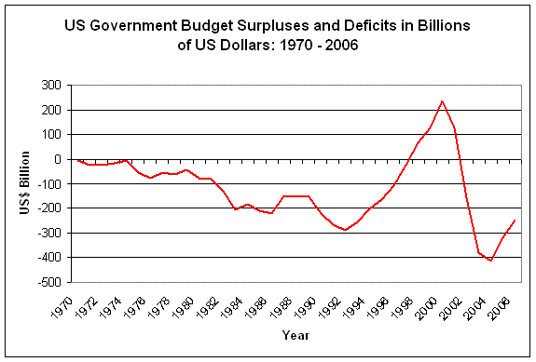
US Budget Surplus and Deficits

Slide 11
Effects of Deflationary FP
Decreasing AD
Cut in government spending (G) and/or increase taxes.
Higher taxes will reduce consumer spending (C) means (- C)
Through tight FP tend to cause a boost in the government budget deficit.

